Slide 1
Treasurer’s Report
Summer 2022 Assembly

Slide 2
Donations
Please include your group # on checks.
Address for Donations:
AFG of Colorado
3720 Parfet St.
Apt. 2
Wheat Ridge, CO 80033

Slide 3
Expense Reports
Expense Reports are available at:
https://al-anon-co.org/treasurer/
Please submit within 30 days by email to:
treasurer@al-anon-co.org

Slide 4
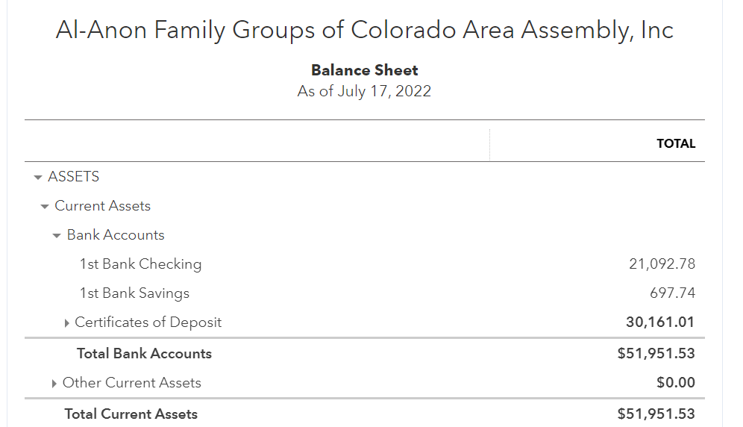
Assets
Notes:
This does not include the Weekend In Al-Anon account, which is separate.

Slide 5
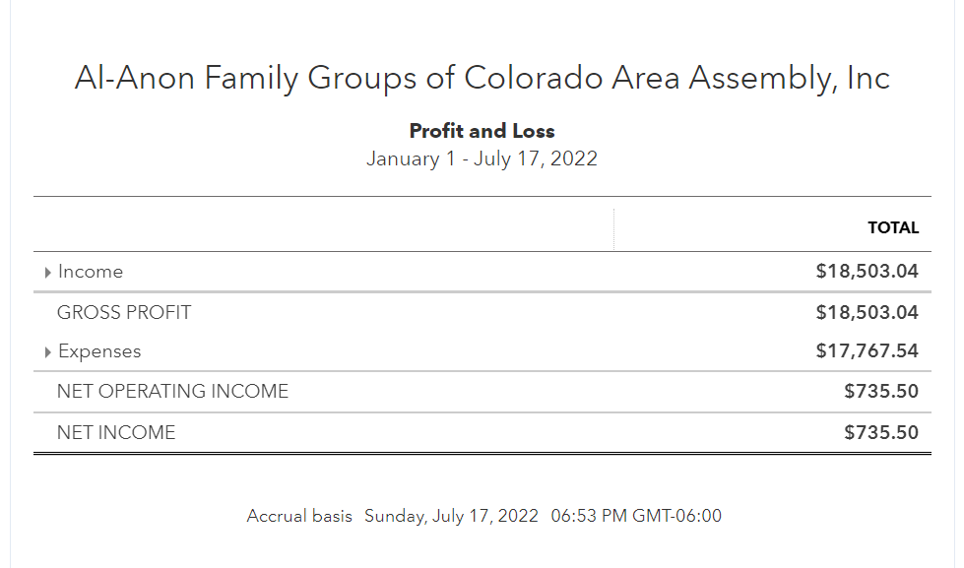
2022 Income & Expenses

