Slide 1
Task FORCE Inclusion of E-meetings in our Colorado Area Structure
Spring 2023 Assembly
Task Force Members
Mike R. Task Force chair
Rick G. former Colorado Delegate panel 59
Willard D. Colorado Area Group Records Coordinator
Kara K.

Slide 2
Task Force Report: Inclusion of E-meetings in our Colorado Area Structure
Task Force Charge:
Using KBDM, define how Colorado will include electronic groups into our Al-Anon structure? Considerations:
Suggest where in the Area structure the electronic group shall join, examples may include:
Create an overlay District (similar to District 25, our Spanish speaking groups);
Become part of an existing District based on where the GR lives;
Other
Develop guidelines for inclusion (examples may include):
GR must be a CO resident to attend Assemblies in person, and other Considerations.
Develop a method for electronic groups to petition to be part of the Colorado Area.
Prepare recommendations to the AWSC regarding the above information, keeping in mind what would best serve the needs of our members and Area. (Chairperson will supply the Template for Task/Thought Force Final Reports).

Slide 3
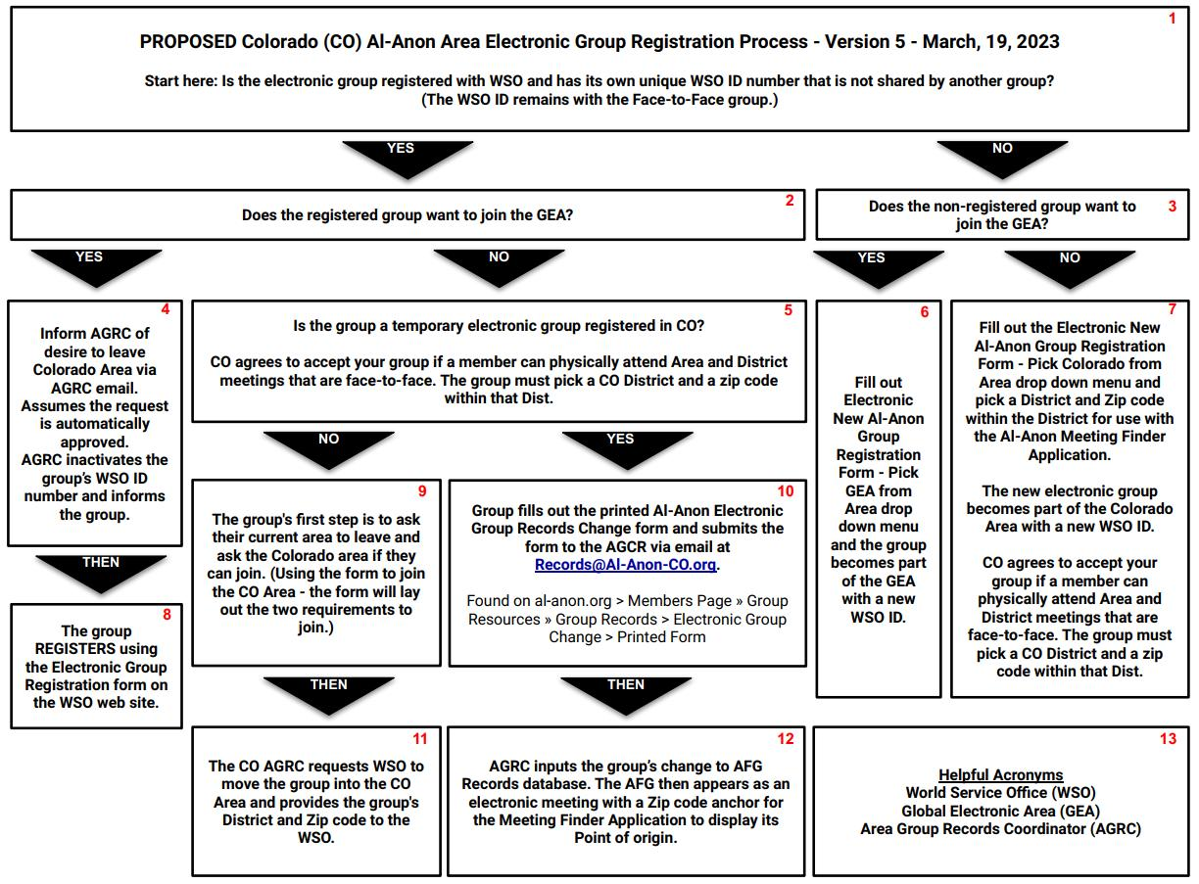

Slide 4
Colorado Area’s process for electronic groups to join the Colorado Area.
1. If the electronic group is registered with WSO and has a unique WSO ID number that another group does not share. In that case, the group can petition to join the Colorado Area, given the following requirements.
a. If the group is part of the Global Electronic Area (GEA), the group would need to petition to leave the GEA before petitioning to join the Colorado Area.
b. When petitioning to join the Colorado Area, the group selects a District within the Colorado Area and a zip code within the District.
c. The electronic group needs to find a member available to attend Colorado Area assemblies and District meetings.
d. The zip code will be used to support WSO’s GEO tag Meeting Finder so the group can be located through the Al-Anon website.
2. If the electronic group has an in-person component. In that case, the WSO ID remains with the in-person group, and the electronic group would register with the WSO as a new group and petition to join the Colorado Area or Global Electronic Area.
a. Groups wanting to join the Colorado Area agree to bullets 1b to 1d above.
b. This also applies to temporary electronic meetings in the Colorado Area.
3. Electronic groups in the Colorado Area requesting to leave the Colorado Area for another Area would be approved to leave the Colorado Area.
4. Additional details are outlined in the process diagram, such as where to locate specific forms.

