Slide 1
WINTER ASSEMBLY 2025 DELEGATE’S REPORT
CRIPPLE CREEK, CO. THANK YOU TO DISTRICT 16 FOR HOSTING

Slide 2
ANNOUNCEMENTS SINCE LAST ASSEMBLY
75TH Anniversary event scheduled and tickets for purchase
  https://al-anon.org/world-service-office-events/
  Tickets at $75 per person and GOING FAST!!
SWRDM 2026: Oceanfront Outrigger Kaua’i Beach Resort & Spa on, Kaua’i, HI, March 13 - 15, 2026. Location in flux, TBA

Slide 3
ANNOUNCEMENTS SINCE LAST ASSEMBLY
Colorado’s trustee application has been submitted and the process is now confidential and I will not have any updates on what is happening until after the 2026 WSC
WSO Ebook launch was deemed a success and they plan to release a digital version of each book per month until all are digital.

Slide 4
THREE BIG CONVERSATIONS
E-AL-ATEEN
GROUP NAMING POLICY
SINGLE TRUSTEE PROCESS
Thank you to everyone that has invited me to their groups and/or Districts to have these conversations. You are all an inspirations every day!

Slide 5
GROUP NAMING POLICY
Key Points To Remember:
The new policy is in place, it is the implementation that is on pause
Existing groups are not / will not be asked to change their names
Even with the new implementation, groups can be focused on a certain group of people but that focus would just not be in the name so there’s no confusion over who is allowed.

Slide 6
GROUP NAMING POLICY
Conversation Thus Far:
  Those that agree with the implementation have said such things as “It can be more inclusive”, “Do names matter, as much as having a healthy meeting?”, “The website allows focus so it isn’t going away”, “The names can imply that groups do not have to welcome everyone.”

Slide 7
GROUP NAMING POLICY
Conversation Thus Far:
  Those that disagree with the implementation have said such things as “Group names can create a safe environment”, “This is a problem with education about traditions and policies, not a problem with names”, “We’ll create a hierarchy of groups with identifiers and ones without them”, “This is not the appropriate time in our society to divide the fellowship over names.”

Slide 8
SINGLE TRUSTEE PROCESS
Key Points To Remember:
Even if the 2026 wsc votes to proceed with a single trustee process, it’ll be a multi-year change until it is fully in place (it will not impact the most recent trustee application)
the number of trustees would not change, only the application process
the WSO’s goal for seeking this change is to help the WSO become fully staffed as regional trustees often remain unfilled

Slide 9
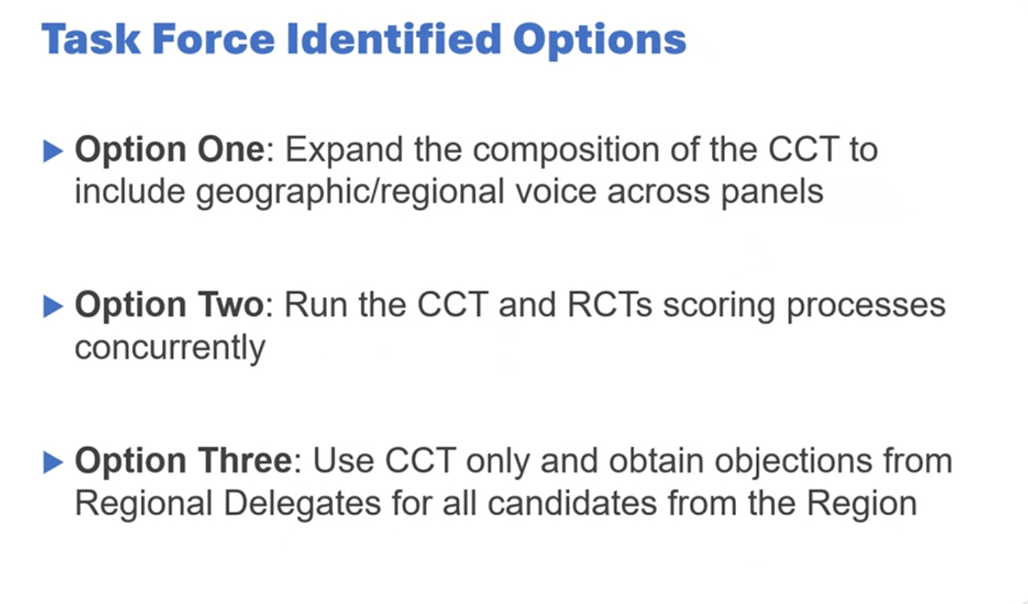

Slide 10
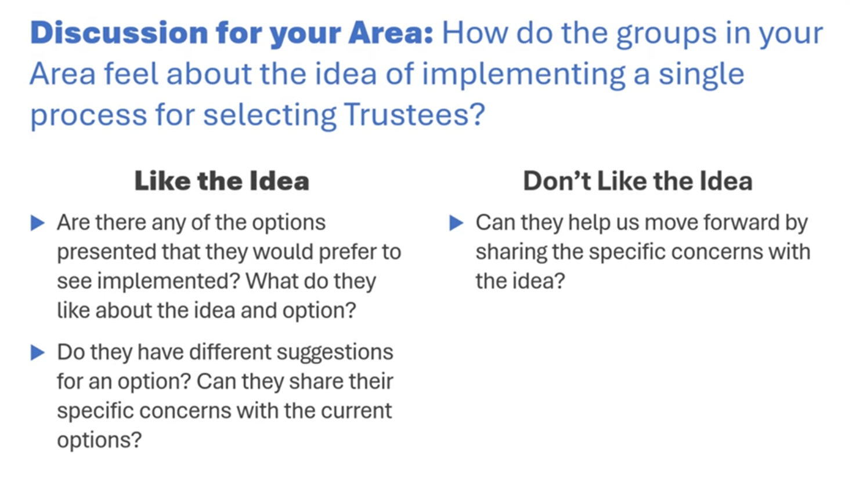

Slide 11
E-AL-ATEEN
KEY POINTS TO REMEMBER:
Meetings would be hosted by an area and thus subject to the Alateen Safety and Behavioral Requirements (SBR)
An area would have to update their SBRs to cooperate with the wso’s new E-SBRs and the area’s updates would need approved by the wso before E-Al-Ateen meetings could start
A teenager would have to register with the meeting proving they live within that area and must provide a guardian’s approval to attend

Slide 12
ELECTRONIC AL-ATEEN
The trial is set to start Summer of 2026 so we as an area should vote on if we want to proceed with this at the spring assembly in March of 2026.
If we do, we will need to get our SBRs reviewed by a task force and legal counsel to make sure they are in compliance with wso’s, then we will have to send ours to wso for approval.
Approval can take time so if we want to get this process started, we could vote to start the task force at this assembly if the GRs feel strongly enough to do so.

Slide 13
Q&A TIME
Didn’t get a chance to ask a question at the mic? Email TMF
delegate@al-anon-co.org

