Slide 1

Delegate’s Spring 2026 Assembly Report
FORT COLLINS, MARCH 21ST, 2026

Slide 2
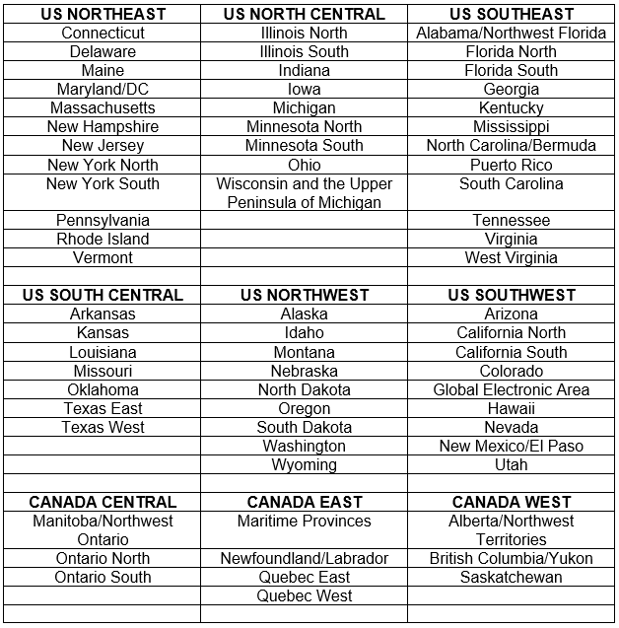
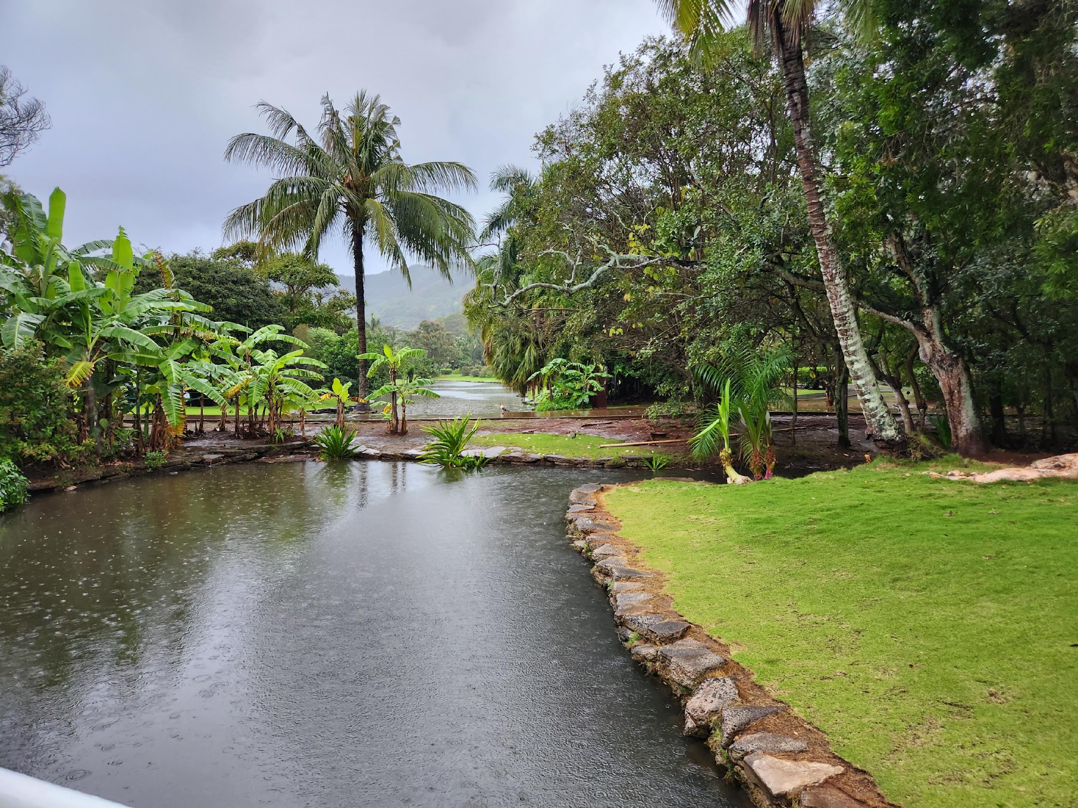
SWRDM 2026
Our Region
Our Area

Slide 3
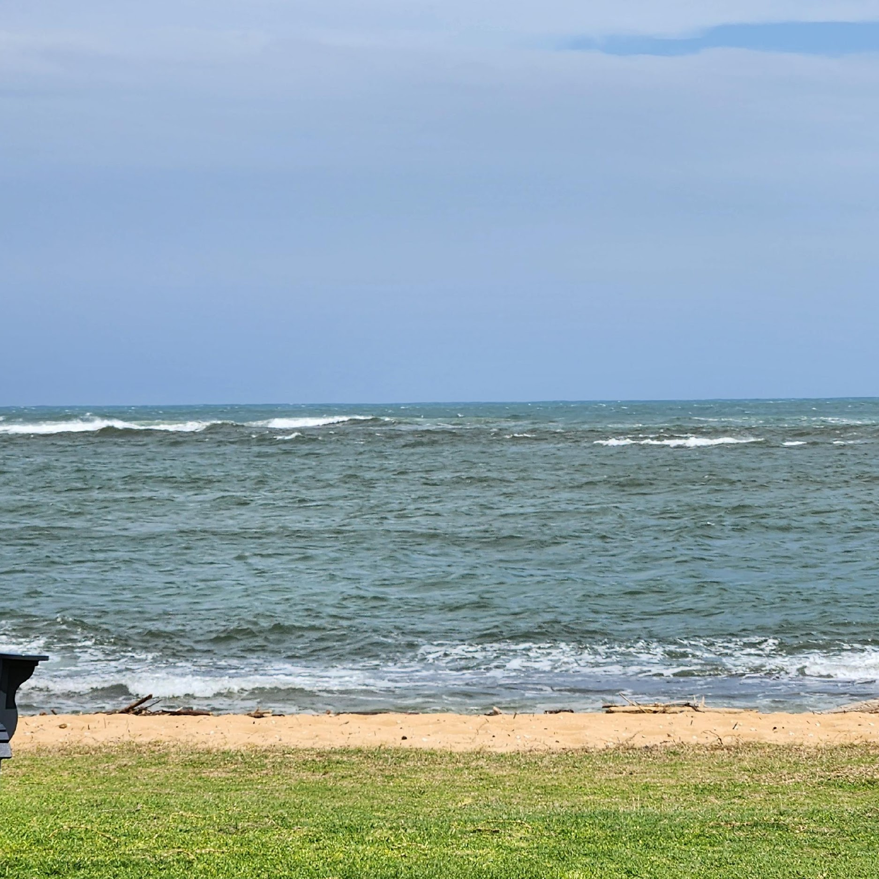
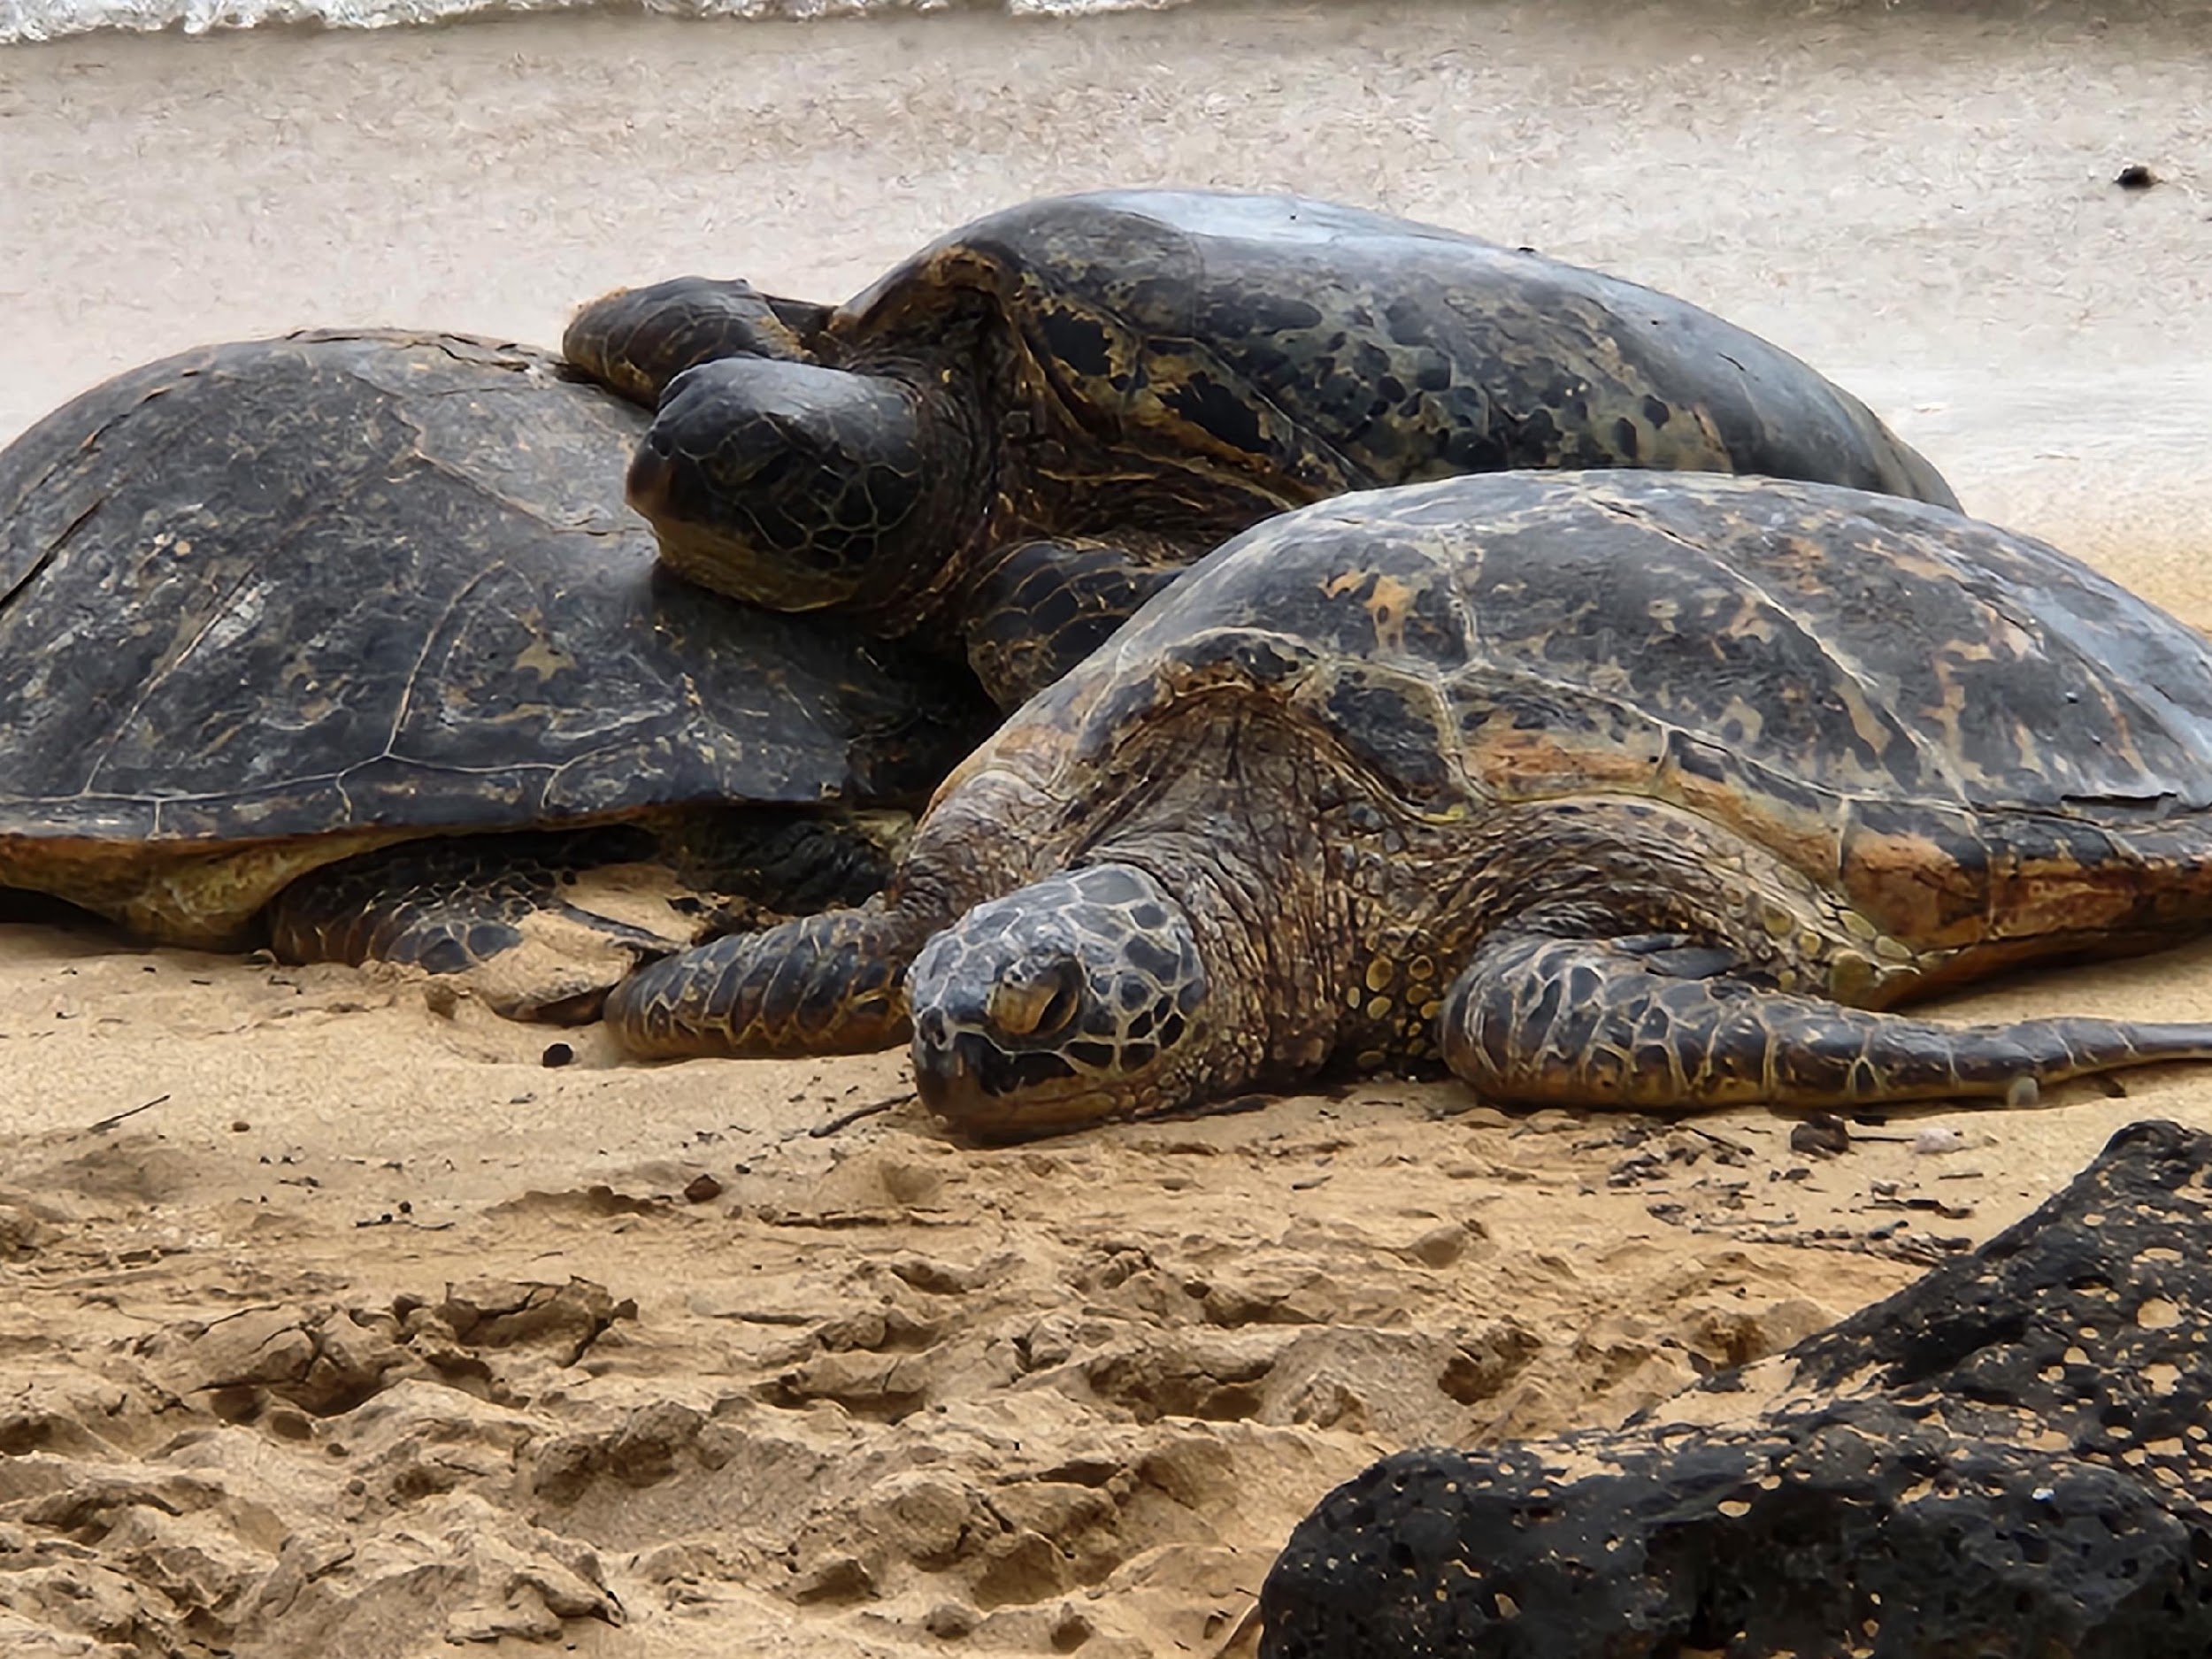
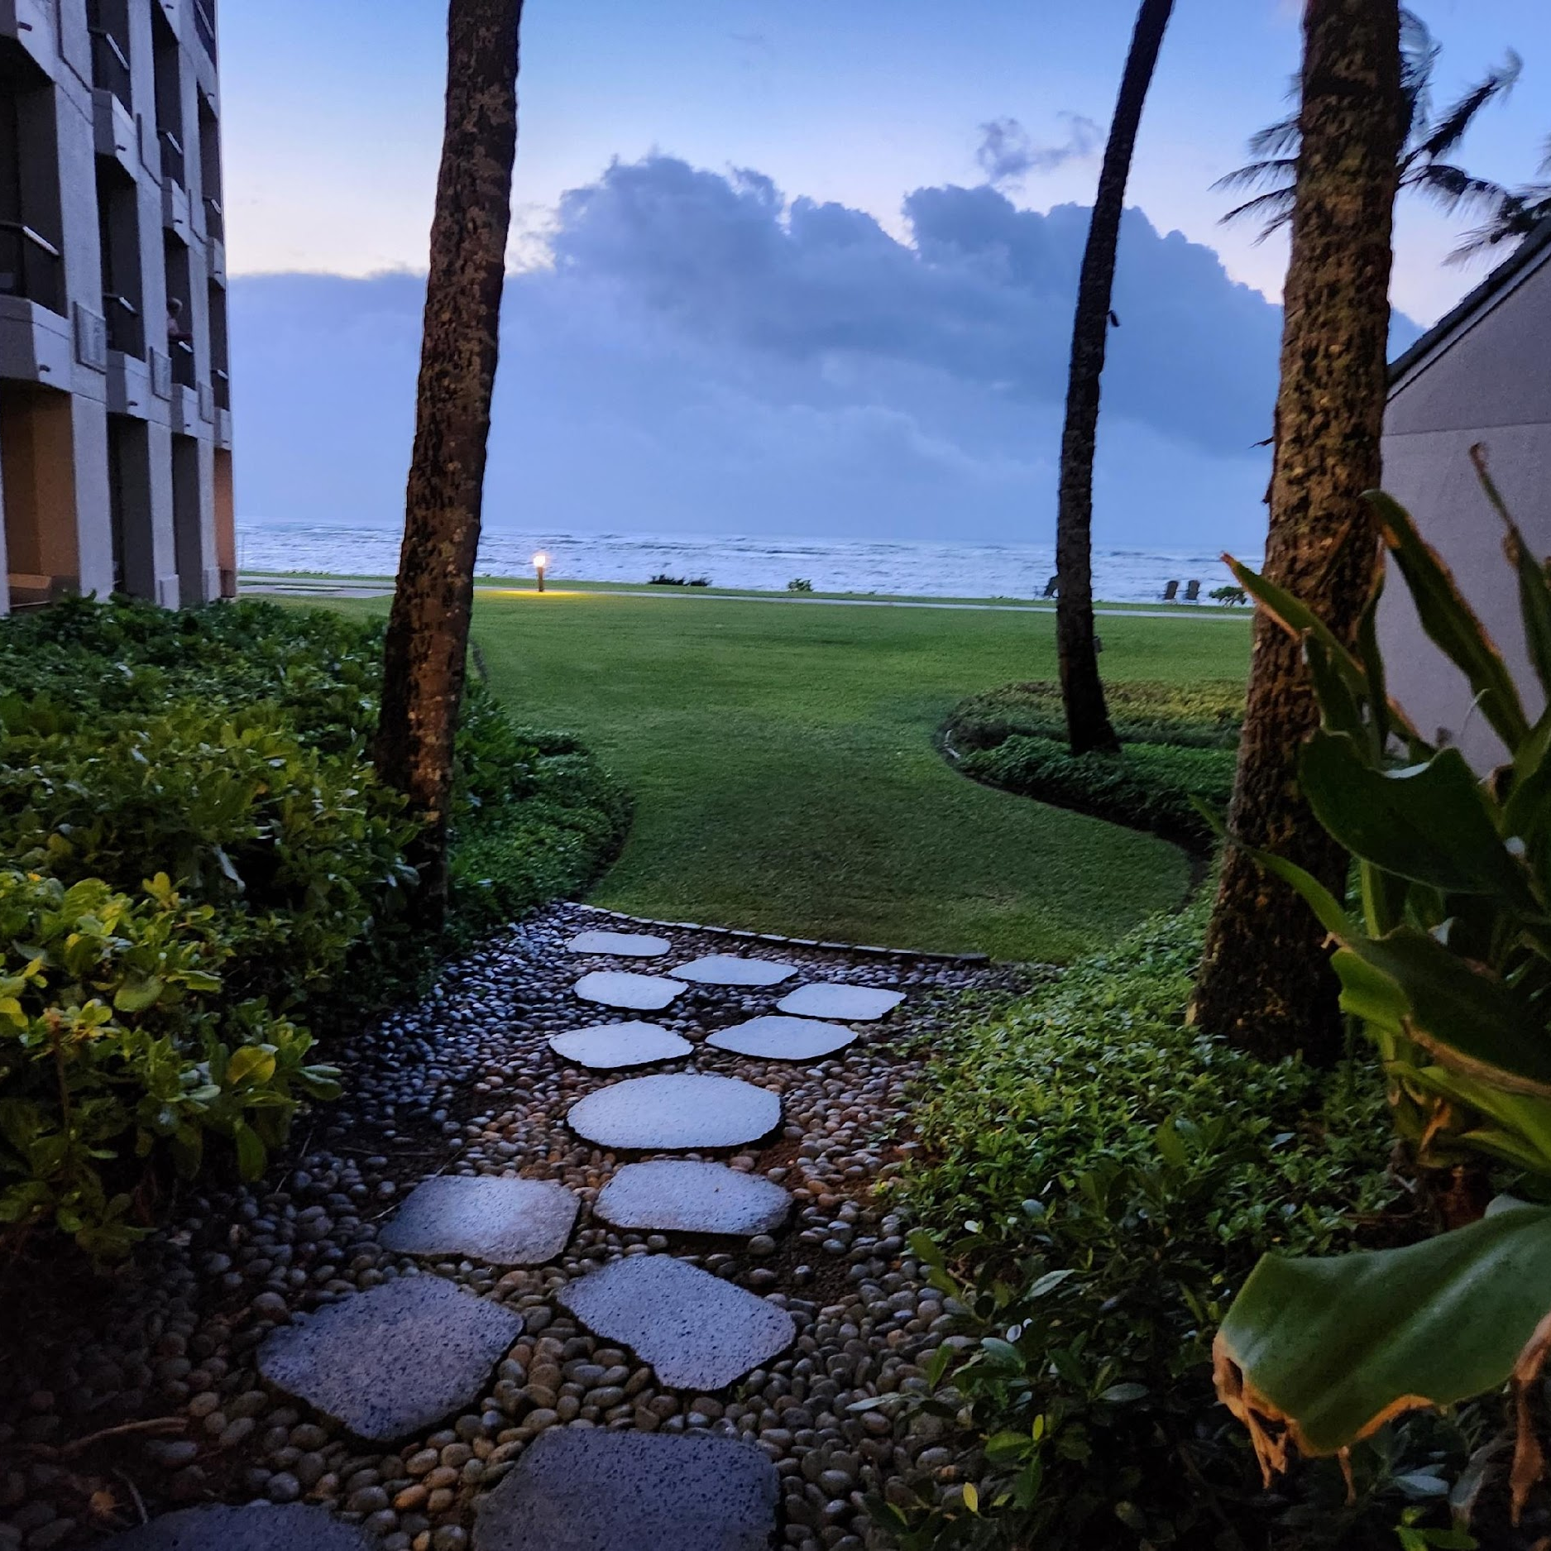
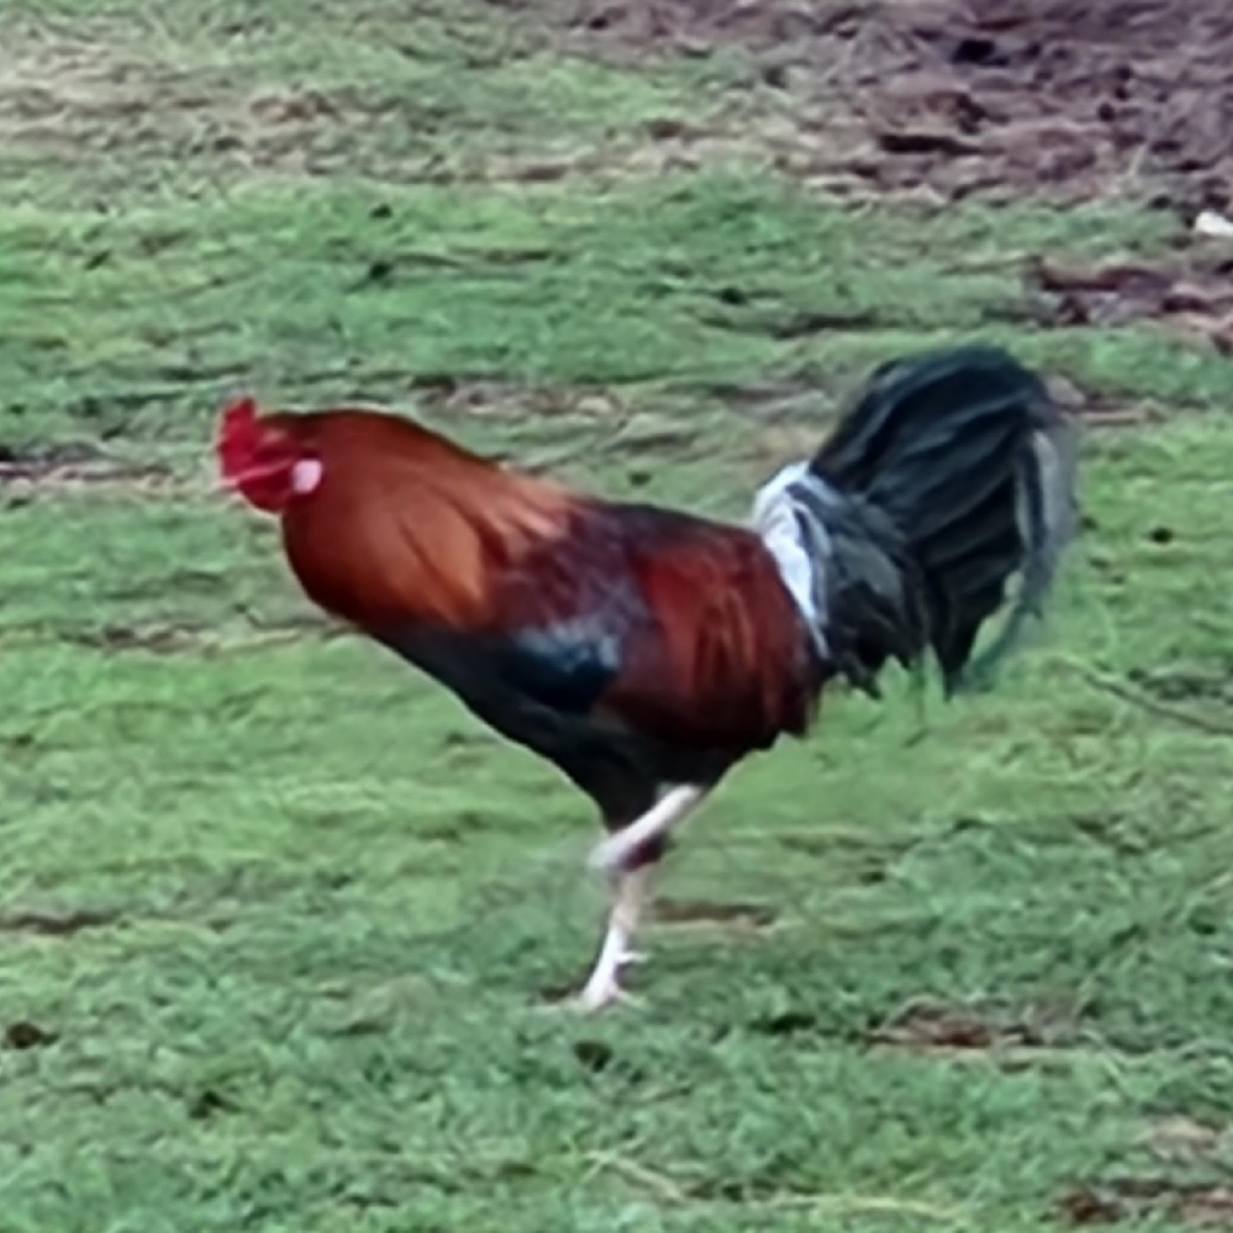
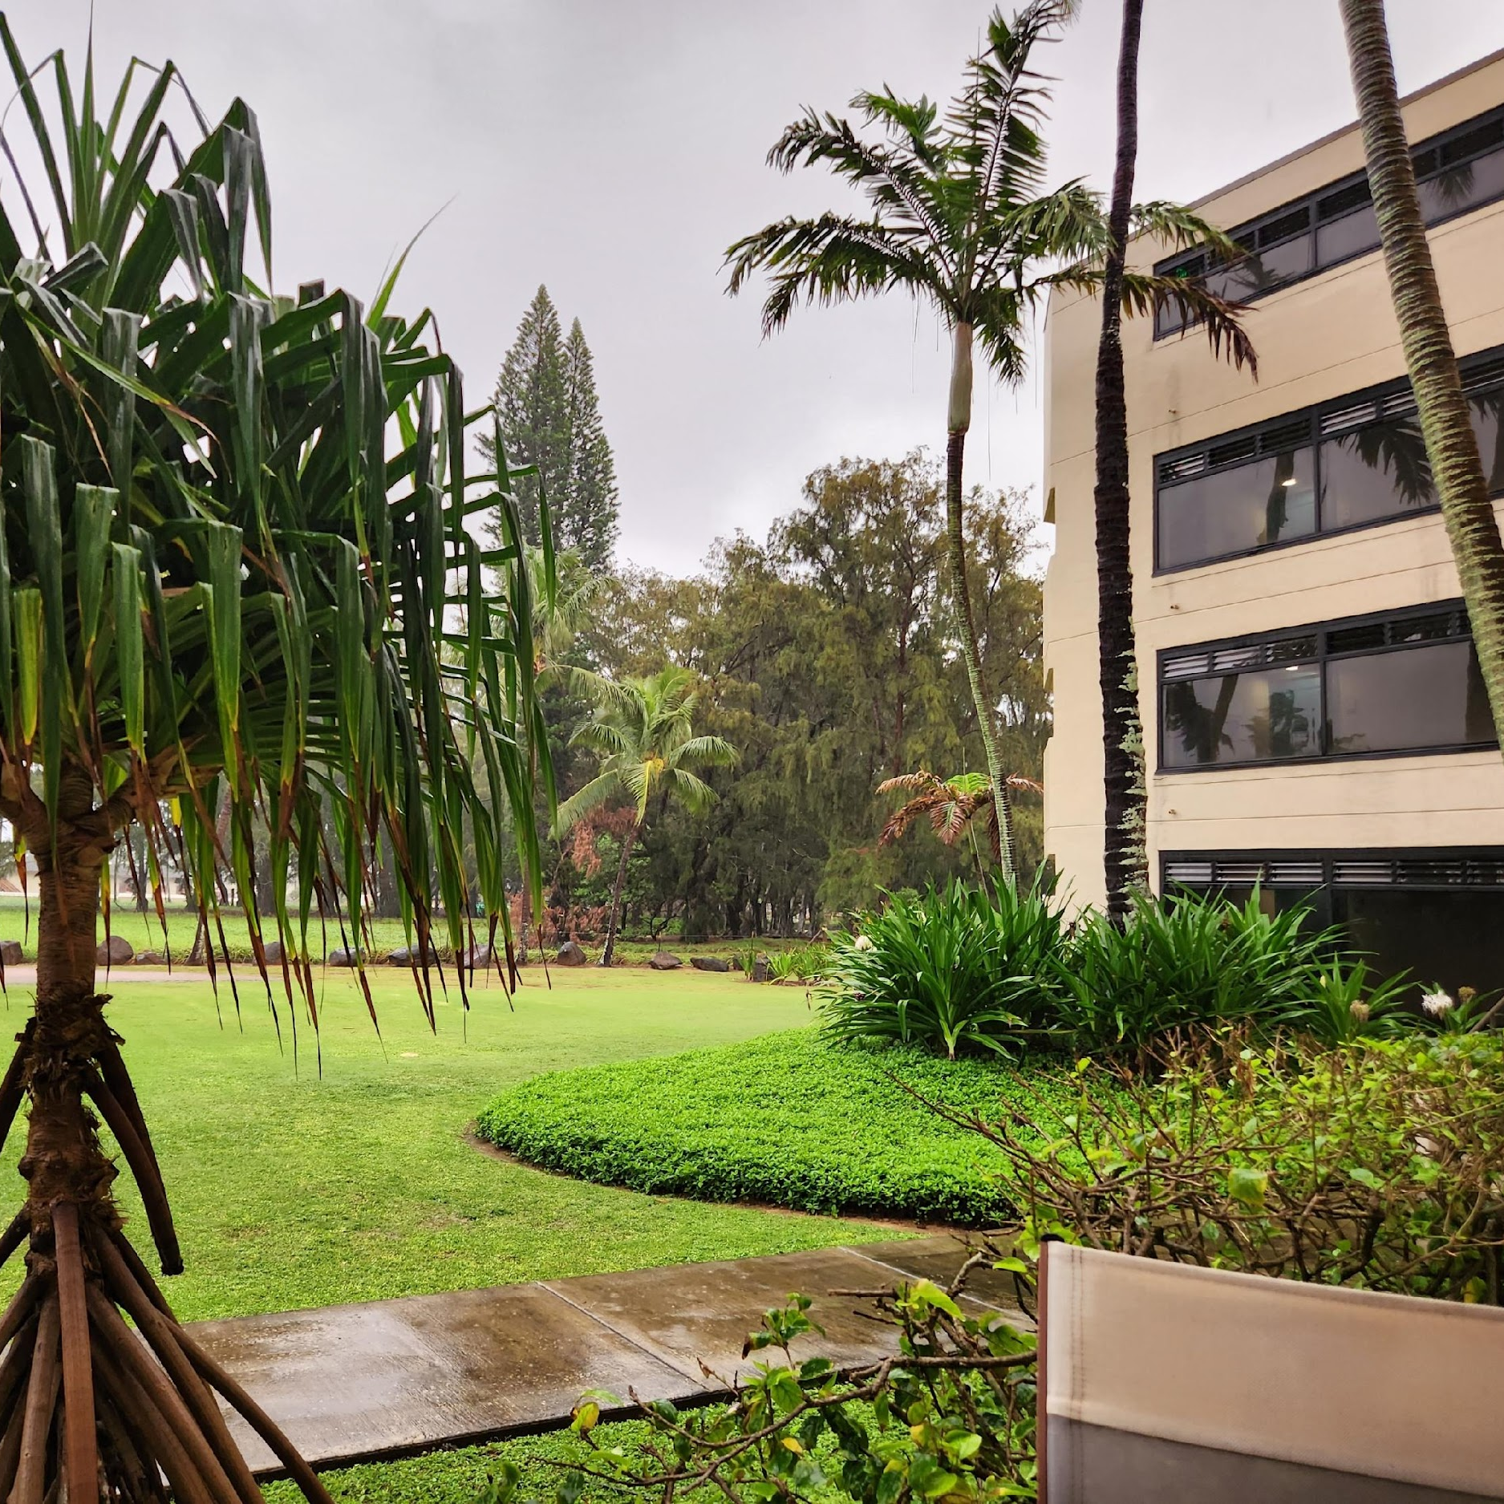
Poipu Beach

Slide 4
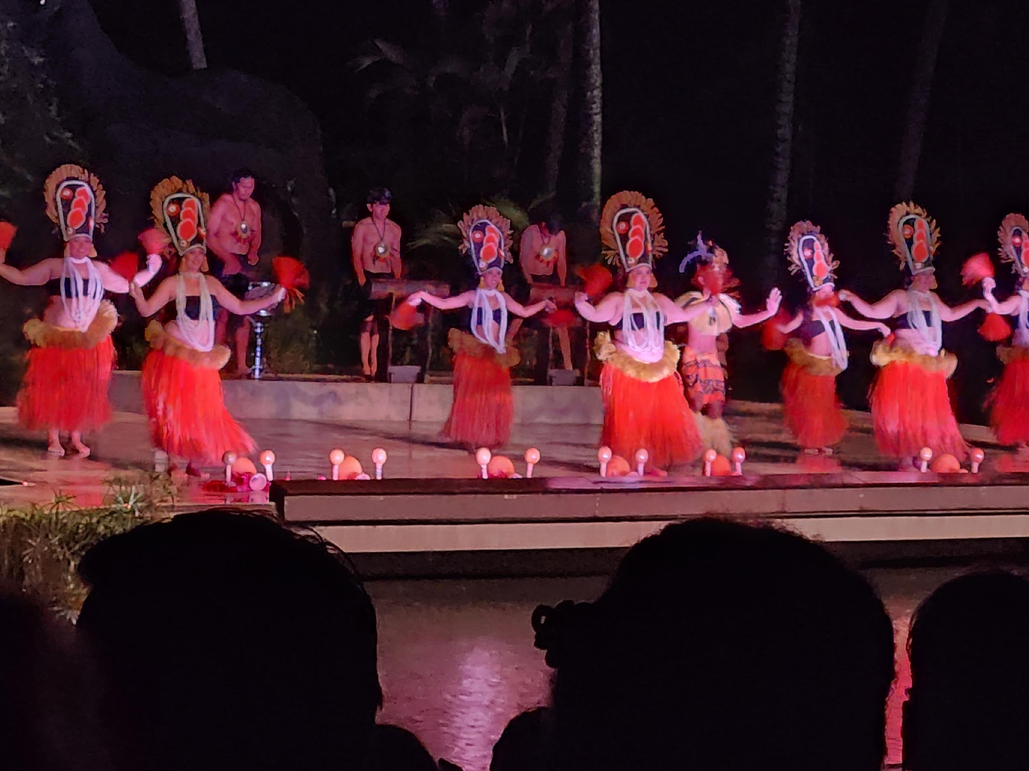
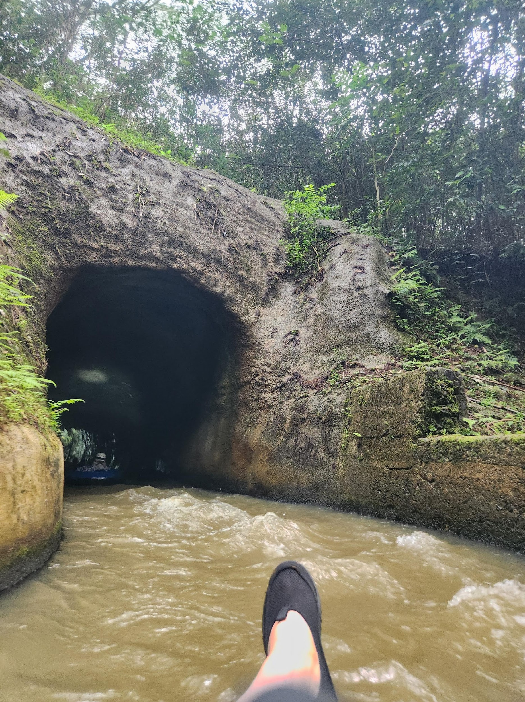

Slide 5
SWRDM 2026
Board Goals:
  Goal #1 : The Spiritual Tone of the Conference
  Goal #2 : Mutual Respect and Guidance for Conference/Delegates
  Goal #3 : Conference members understand the purpose of the conference

Slide 6
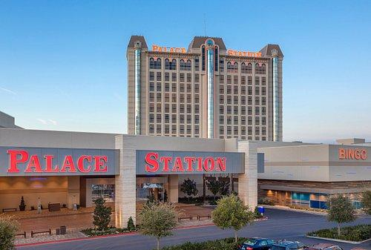
SWRDM 2027
Las Vegas, Nevada
March 12th – 14th

Slide 7

What is your Delegate doing?
Wrapping up a Taskforce where we designed a skit for Conference to teach members about the Charter.
On a Taskforce to aid in developing Public Outreach Toolkit for WSO
Chairing Area Taskforce on Electronic Alateen
Traveling to share E.S.H. with Al-Anon as a whole
Reviewing documentation in preparation for WSC 2026

Slide 8
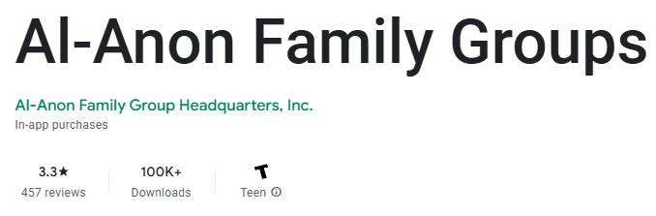
CAI 2026 Submissions
CAI #1
Is Al-Anon, as a whole, being impacted positively or negatively by the increasingly more common dilution/outside practices/phrases?
CAI #2
Is the Al-Anon App a success or failure according to WSO and the WSC?

Slide 9

WSO is creating a pamphlet on how to use AI in Al-Anon
IN THE MEANTIME, PLEASE DO NOT UPLOAD ANY C.A.L. OR OTHER AL-ANON COPYRIGHTED MATERIALS TO AI SYSTEMS AS THAT IS A VIOLATION OF THE COPYRIGHT.
WHILE NOT ILLEGAL, BREAKING AL-ANON COPYRIGHT DOES INFRINGE ON OUR PRINCIPLES.

Slide 10
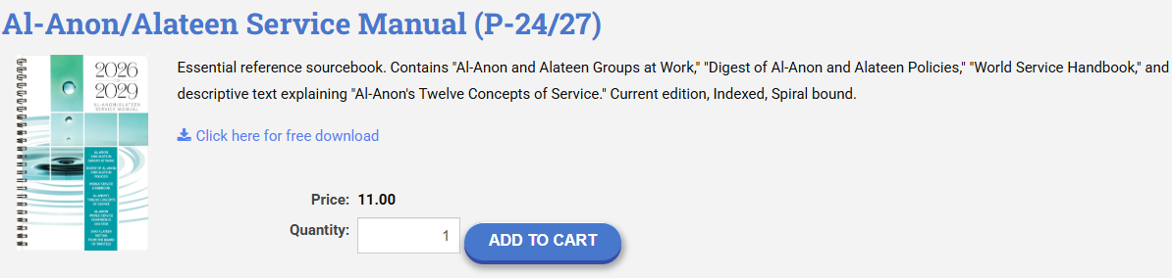
Service Manual
2026-29 available for purchase
It is recommended to bulk order with a local LDC or the Denver Service Center
HTTPS://ECOMM.AL-ANON.ORG/ITEMDETAIL?IPRODUCTCODE=P24_27&WEBSITEKEY=DB6E68F1-B2FE-4AAA-BAEA-928D4E696DCC

Slide 11




SWRDM/COB Letters
Conference Leadership Team
Policy Committee
Financial Report
Chairperson of the Board

Slide 12
World Service Conference 2026
Conference Theme:
  75 Years, One Purpose
  75 años, un propósito
  75 ans, un but
Address:
  Newport News Marriott at City Center Hotel 740 Town Center Dr., Newport News, VA 23606
    Can send Delegate letters/postcards, but NO PACKAGES will be accepted by the Hotel

Slide 13
World Service Conference 2026
Conference is from April Monday 20th – Friday 24th with the 75th Gala on Saturday 25th
Still accepting Love Gifts for our Al-Anon family members across the world until April 15th.
  Reach out to TMF directly for mailing address
75th Anniversary Gala Tickets are sold out
  There is a waitlist but it’s first come first serve and does not guarantee a ticket

Slide 14
World Service Conference 2026
Agenda:
  Choosing a Group’s Name” Policy Implementation
  Single Trustee Process
  Alateen Electronic Alateen Validation & Implementation Planning
  Delegate Task Forces
  Visiting the WSO Office + Al-Anon meeting

Slide 15
Policy Committee Updates
Thought Force: Interim Policies and Policy Revisions Process (Classified)
Discussion on the “Digest of Al-Anon and Alateen Polices” Changes Necessary to Support Alateen Groups Meeting Electronically (WSC Vote)
“Choosing a Group’s Name” Policy Implementation Discussion (WSC Vote)
Al-Anon Branding Guideline for Trusted Servants Tagline Recommendation
Housekeeping Changes “Who can Start a Group” Policy (Alateen)
Revised Staff Policy Implementation Round Table (SPIRiT) Purpose

Slide 16
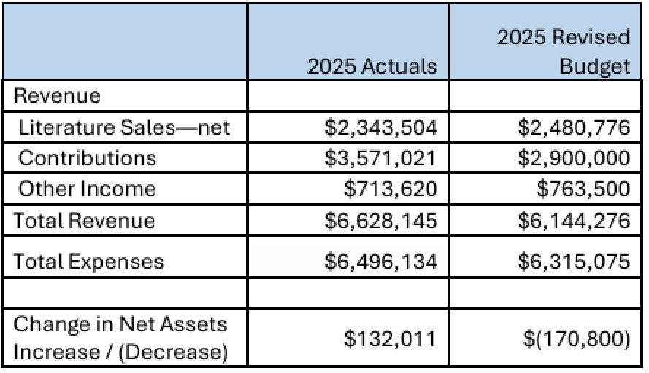
Finances
MAIN TAKEAWAYS:
CAL SALES ARE DOWN, EVEN THE HOLIDAY BUNDLE DIDN’T SELL WELL.
THE WSO WOULD HAVE ENDED 500K IN THE HOLE IF NOT FOR BEQUESTS.
WSC MEMBERS ARE ASKED TO CONTINUE TO SPREAD THE WORD THAT WSO NEEDS SUPPORT DURING THESE TIMES.

Slide 17
Finances
MAIN TAKEAWAYS:
In 2024 only 62% of Groups contributed to the WSO, with an average of $203.
Will have 2025 numbers after WSC 2026, but it is estimated that the current cost for WSO to support each group is ~$350 for a year.
Only Al-Anon members can make Bequests, you must make WSO aware before you pass, and they can be for any amount.

Slide 18
Chairperson of the Board
THE BOARD MEETING BEGAN ON JANUARY 12, 2026. THE TRUSTEES SPENT FOUR DAYS INTERVIEWING CANDIDATES AND DISCERNING WHICH TRUSTEE NOMINEES TO PUT FORWARD TO THE WORLD SERVICE CONFERENCE FOR AFFIRMATION.
THEY RECONVENED JANUARY 27–29, 2026, TO COMPLETE THE REMAINDER OF OUR BOARD AGENDA.

Slide 19
Nominees for Regional Trustee:
Robert “Bob” C., Southeast Region, first term as Trustee, fulfilling remaining two‑year term
Miriam B., North Central Region, first term as Trustee, fulfilling remaining two‑year term
Noah P., Northeast Region, first term as Trustee, fulfilling remaining two‑year term
D. DeLynn H., South Central Region, first three‑year term
Thomas “Tom” B., Southwest Region, first three‑year term
Nominees for Trustee-At-Large:
Jayme C., second three‑year term
Jeffrey “Jeff” F., first three‑year term
Clara C., first three‑year term

Slide 20
Board Officers:
• Katherine “Kathi” M., Chairperson of the Board, third one-year termrm
• Debbie P., Vice‑Chairperson of the Board, first one-year term
• David B., Treasurer, second one-year term
Executive Committee for Real Property Management (ECRPM)
• Brianna M., three‑year term
Executive Committee:
• Angela A., third one-year term
• Kari O., second one-year term
• Cindy B., first one-year term
Chairperson of the Executive Committee
• Kari O., first one‑year term
Chairperson of the Executive Committee for Real Property Management
• Lori H., second one‑year term

Slide 21
STRATEGIC PRIORITIES AND PROJECTS
• WSO CORE SYSTEMS – BOTH CRM/AMS AND ACCOUNTING SYSTEMS
• ELECTRONIC ALATEEN VALIDATION AND IMPLEMENTATION PLANNING
• EBOOKS GLOBALLY
• 2026–2029 AL‑ANON/ALATEEN SERVICE MANUAL
• CAL GLOBALLY
• REFRESH OF AL‑ANON FACES ALCOHOLISM (AFA)
• PASSING IT ON
• AFG, INC. BRANDING GUIDELINES FOR TRUSTED SERVANTS
• SHAREPOINT IMPLEMENTATION FEASABILITY

Slide 22
Chairperson of the Board
WSO CONSIDERED THE REQUESTS TO MAKE ROAD TRIP HYBRID, BUT HAS DECIDED THAT ROAD TRIP IS BEST EXPERIENCED IN PERSON.
ONLINE ONLY VERSIONS ARE BEING LOOKED AT AS POTENTIAL POSSIBILITIES IN THE FUTURE.

Slide 23
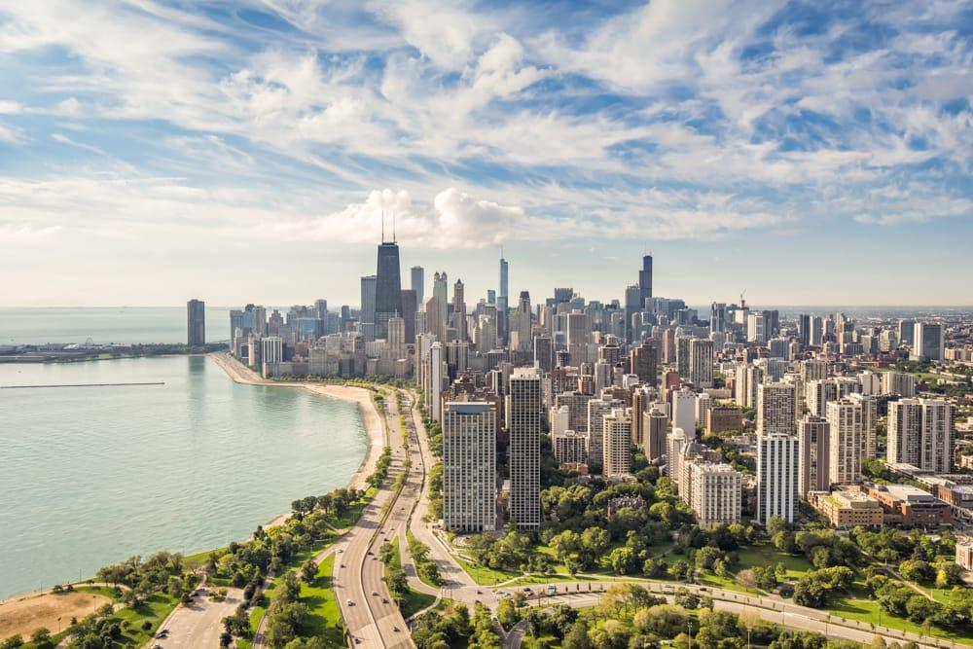
2026
ROAD TRIP
CHICAGO, ILLINOIS
OCTOBER 19–24, 2026

Slide 24

2028
Al-Anon
International Convention
MINNEAPOLIS, MINNESOTA
JULY 20-23, 2028

Slide 25
Questions???

